Slide 1

DIGITAL DESIGN AND COMPUTER ORGANIZATION
Memory Locations And Addresses
T2: Chapter 2: 2.2
Department of Computer Science and Engineering

Slide 2
Memory Locations And Addresses Introduction(T2- section 2.2)
Main memory is a collection of semiconductor storage cells,
Each Cell can store one bit of information say a “1” or a “0” bit.
Memory stores binary information in groups of bits called words.
Memory word is an addressable location to store a number, characters as data or an instruction in binary.
The length of a memory word can be specified as n-bits per word called the word length.
Modern computers have word length of the order 16-bits to 64-bits.
8 bits= 1 byte

Slide 3
Memory Locations And Addresses Memory Addresses
Each word of information to be stored or retrieved from memory requires an identifying name called its Address.
Special input lines called Address lines (wires) select each and every word in memory distinctly.
For which each word in memory is assigned an identification number, called as address starting from 0 and continues 1,2,3,……….,up to 2^{k} where k is the number of address lines.
The selection of a specific memory word is achieved by applying the K-bit binary address to the address lines.
The address range from 0 to 2^{K} – 1 constitute address space comprising 2^{K} memory words.

Slide 4
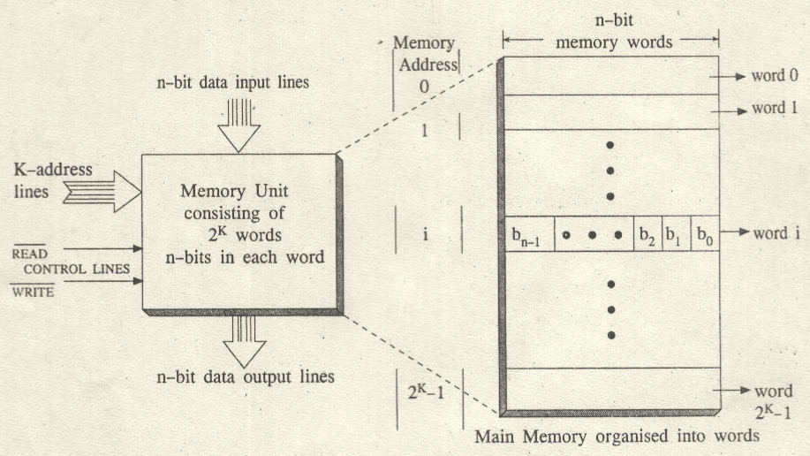
Memory Locations And Addresses Memory Organization and Addressing

Slide 5
Memory Locations, Addresses, and Operation
It is impractical to assign distinct addresses to individual bit locations in the memory.
The most practical assignment is to have successive addresses refer to successive byte locations in the memory – byte-addressable memory.
Byte locations have addresses 0, 1, 2, … If word length is 32 bits, they successive words are located at addresses 0, 4, 8,…
1 Tera= 2⁴⁰
1Giga=2³⁰
1 Mega=2²⁰
1 Kilo=2 ¹⁰
2²⁴ can also be called 16MB

Slide 6
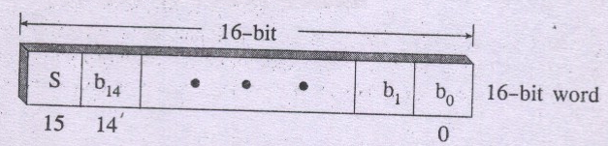
Memory Locations, Addresses, and Operation Encoding of Information
Numbers
The length of the operand depends on the specific data type. 16 - bit
16 – bit memory word pattern to hold integer numbers.
Bit 15 indicate sign bit🡪 If it is 0, number is +ve
If it is 1, number is –ve
Binary number 0000 0010 0001 1101 is interpreted as a decimal +541

Slide 7
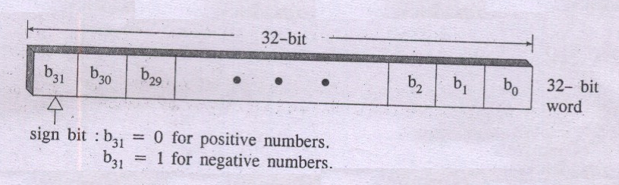
Memory Locations, Addresses, and Operation Encoding of Information
32-bit memory word pattern to hold integer numbers
Magnitude of the number can be computed using binary positional weight notation as:
= b₃₀ x 2³⁰ + b₂₉ x 2²⁹ + ……………+b₁ x 2¹ + b₀ x 2⁰
Magnitude represented in 32 –bit memory words using signed – magnitude representation can range from 0 to 2³¹ – 1.

Slide 8
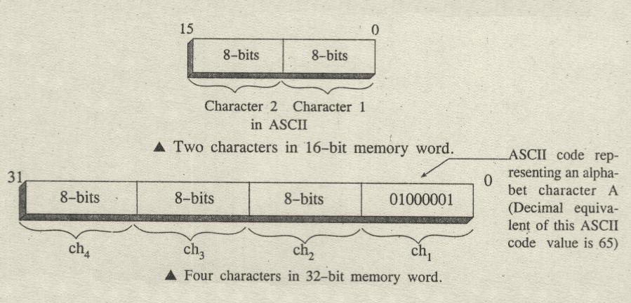
Memory Locations, Addresses, and Operation Characters
Characters
A memory word can also store character information such as alphabets, decimal digits, symbols like +, -, $, ?, punctuation marks like; :,’ “ etc., Such characters can be represented using a 7-bit ASCII code. Memory Word Bit pattern to represent characters

Slide 9
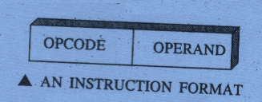
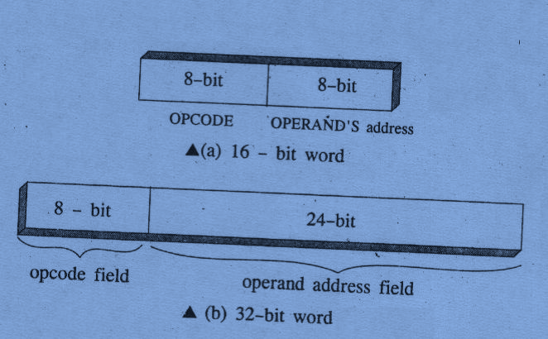
Memory Locations, Addresses, and Operation Instructions
Instructions
Program instructions are also stored in main memory words. An instruction has two parts : operation code (opcode) and operand field:
A machine instruction format in 16-bit and 32-bit memory words:

Slide 10
Memory Locations, Addresses, and Operation Instructions
The magnitude of the number in 16-bit memory word is computed as
= b₁₄ x 2¹⁴ + b₁₃ x 2¹³ + ……………+b₁ x 2¹ + b₀ x 2⁰
For a number in signed – magnitude representation,
where in bit 15(b₁₅) specify a sign bit, a 0 or 1.
Now Binary number 0000 0010 0001 1101 has the equivalent magnitude in decimal as:
= 0x2¹⁴ +0x2¹³ +0x2¹² +0x2¹¹ +0x2¹⁰ +1x2⁹ +0x2⁸ +0x2⁷
+0x2⁶ +0x2⁵ +1x2⁴ +1x2³ +1x2² +0x2¹ +1x2⁰
= 512 + 16 + 8 + 4 + 1 = +541

Slide 11
Memory Locations And Address Outline
Byte Addressability
Big-Endian And Little-Endian Assignments
Word Alignment
Accessing Numbers, Characters, And Character Strings

Slide 12
Byte Addressability T2:Ch2 2.2
If the smallest addressable unit in a computer is a word, then such computers are said to be word addressable computer.
A computer in which each byte stored can be addressed individually is called as byte addressable computer.
If the word length of the given computer machine is 32 –bit words, then sequence of memory words can be located subsequently at addresses 0 (word 0), 4 (word 1), 8 (word 2)…
Each such word contains 4 bytes.

Slide 13
DIGITAL DESIGN AND COMPUTER ORGANIZATION
2. Big-Endian & Little-Endian Assignments T2:Ch2 2.2
Department of Computer Science and Engineering

Slide 14
Big-Endian And Little-Endian Assignment
Two kinds of representations in assigning bytes in a memory word are:
(1) Big-endian assignment
(2) Little-endian assignment
Big – endian assignment: Here the bytes are assigned a number starting with most significant byte (left most byte) and successively next bytes in that word. Also the word is given the same memory address as its most significant byte.
Big – Endian scheme of address assignment is used in 68000(CISC processor) processor and Power PC (RISC processor) processors.

Slide 15
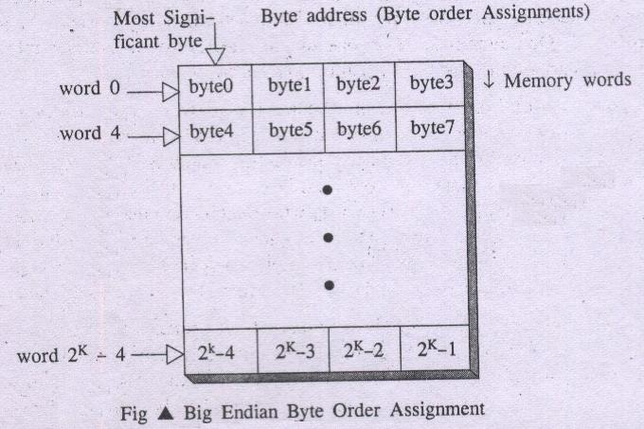
Big-Endian Assignment

Slide 16
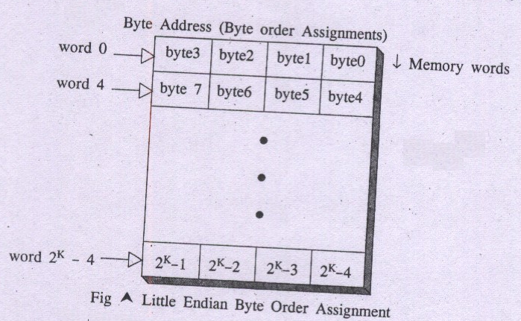
Little-Endian Assignment
In this scheme byte 0 appears as the right most byte of word 0.
Low order bytes represents least significant bytes or right most bytes.

Slide 17
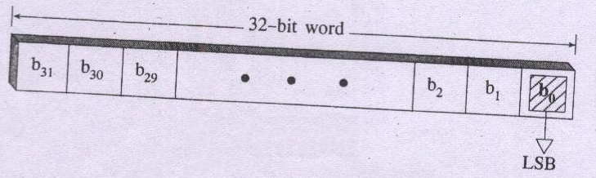
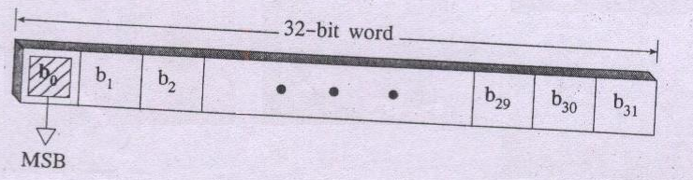
Conventions for numbering bits in a memory word
For example 68000 processor uses a convention in which bit 0 (b0) is treated as least significant bit (LSB) of a word.
Using the other convention, Power PC for example treats bit 0 (b0) as the most significant bit (MSB) of a memory word.

Slide 18
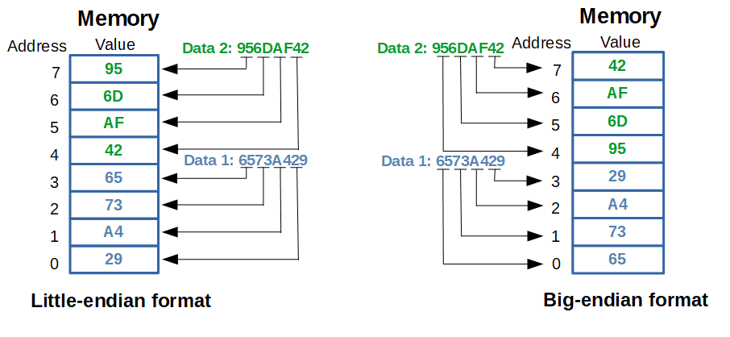
Important

Slide 19
DIGITAL DESIGN AND COMPUTER ORGANIZATION
3. Word Alignment T2:Ch2 2.2
Department of Computer Science and Engineering

Slide 20
Word Alignment
It refers to grouping of bytes in sequence in a given memory unit.
For a computer with 32-bit word length
word 0 at address 0 (comprising bytes 0,1,2,3),
word 1 at address 4 (comprising bytes 4,5,6,7)
word 2 at address 8 (comprising bytes 8,9,10,11) . . .
Similarly for a computer with 16-bit word length:
word 0 at address 0 (comprising bytes 0,1),
word 1 at address 2 (comprising bytes 2,3)
word 2 at address 4 (comprising bytes 4,5) . . .
Similarly for a computer with 64-bit word length:
word 0 at address 0 (comprising bytes 0,1,2,3,4,5,6,7),
word 1 at address 8 (comprising bytes 8,9,10,11,12,13,14,15)
word 2 at address 16 (comprising bytes 16,17,18,19,20,21,22,23) . . .

Slide 21
DIGITAL DESIGN AND COMPUTER ORGANIZATION
4. Numbers, Character and Character Strings T2:Ch2 2.2
Department of Computer Science and Engineering

Slide 22
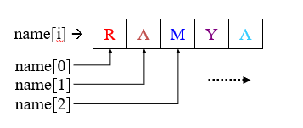
Numbers, Character and Character Strings
Numbers can be accessed from memory unit by specifying its word address or multiple byte address in memory.
Character constants occupy single byte in memory. Therefore they can be accessed specifying their byte address.
For example a character string RAMYA in an array of char can be accessed at byte addresses in memory say bytes 0,1,2,3 & 4
Notes:
Integers can take 2 byte or 4 byte

Slide 23
MCQ
1.A system has 1K words of 16-bit memory. How many address lines are required to address the memory?
8 b) 10 c) 16 d) 32
2. Consider a computer with 32-bit word length using Big-Endian format. If a 32-bit integer is stored at address 1000, which byte holds the Most Significant Byte (MSB)?
a) Address 1000 b) Address 1001 c) Address 1002 d) Address 1003

Slide 24

MCQ
1.A system has 1K words of 16-bit memory. How many address lines are required to address the memory?
8 b) 10 c) 16 d) 32
Answer: b) 10 (Reason: $2^{10}=1024, 1$K words, independent of word size.)
2. Consider a computer with 32-bit word length using Big-Endian format. If a 32-bit integer is stored at address 1000, which byte holds the Most Significant Byte (MSB)?
a) Address 1000 b) Address 1001 c) Address 1002 d) Address 1003
Answer: a) Address 1000 (Big-endian → MSB stored at lowest memory address.)

Slide 25
MCQ
A memory unit has 16 address lines. If the memory is byte-addressable, what is the maximum memory capacity?
a) 64 KB b) 128 KB c) 256 KB d) 512 KB
A computer uses 32-bit word length. In a byte-addressable memory, what are the addresses of the first four words?
0, 1, 2, 3
0, 4, 8, 12
0, 2, 4, 6
0, 8, 16, 24

Slide 26

MCQ
A memory unit has 16 address lines. If the memory is byte-addressable, what is the maximum memory capacity?
a) 64 KB b) 128 KB c) 256 KB d) 512 KB
Answer: (Reason: $2^{16}=65,536$addresses → 64K bytes = 64 KB.)
A computer uses 32-bit word length. In a byte-addressable memory, what are the addresses of the first four words?
0, 1, 2, 3
0, 4, 8, 12
0, 2, 4, 6
0, 8, 16, 24
Answer: b) 0, 4, 8, 12(Reason: Each word = 4 bytes; hence addresses increase by 4 for successive words.)

Slide 27
Think about it
A computer system uses a 32-bit word length with a byte-addressable memory. The system supports both Big-Endian and Little-Endian formats.
The system has 20 address lines.
Calculate the total size of the memory in bytes and words.
If an integer 0x12345678 is stored at starting address 1000, show how the bytes will be stored in Big-Endian and Little-Endian format.
Demonstrate how word alignment affects storage by showing the addresses of the first four words.
If a character string "GATE" is stored beginning at address 2000, show how it is represented in memory.
Briefly explain why byte-addressable memory and endianness conventions are important for system compatibility.

Slide 28
THANK YOU
Team DDCO
Department of Computer Science

